Slide 1

Finding the best place to open a bar in Vitória
Roberto Carlos do N. Siqueira

Slide 2
Finding the best place to open a bar in Vitória
What’s the best place to open a bar in the city?
How can we evaluate this?

Slide 3
Data acquisition and cleaning
There are three sources of our data:
Foursquare
“Vitória Bairro a Bairro – 2013” report (http://legado.vitoria.es.gov.br/regionais/geral/publicacoes/Vitoria_bairro_bairro/Vit%C3%B3ria_bairro_%20a_bairro.pdf)
“Administrative regions – Vitória” report (http://legado.vitoria.es.gov.br/regionais/geral/dados/reg_adm_ger.pdf)

Slide 4
How the sources will be used?
Foursquare
The Foursquare will be responsible to show others main bars in Vitória.
“Vitória Bairro a Bairro – 2013” report
This report will provide some informations as Male and Female concentration per region, age range and income class.
“Administrative regions – Vitória” report
Vitória is divided in seven administrative regions. This information will be acquired from this report.

Slide 5
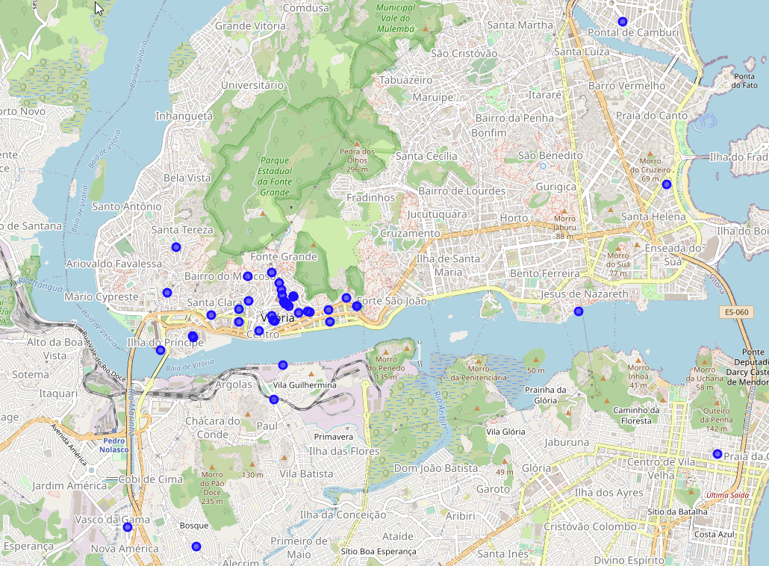
How many bars are there?

Slide 6
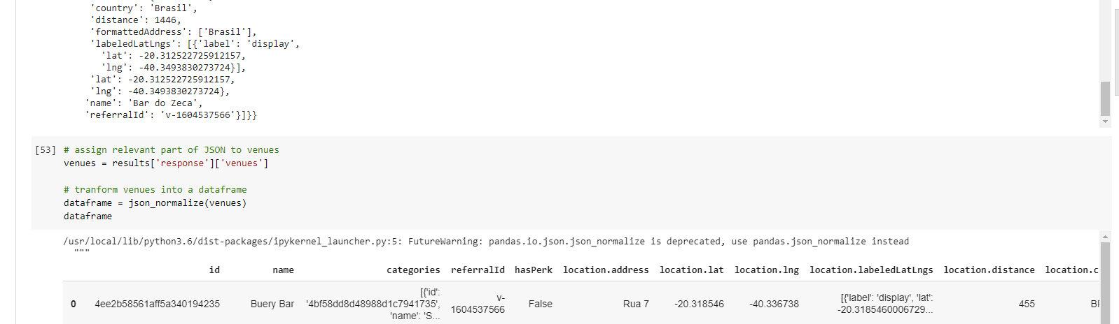
Getting the values

Slide 7
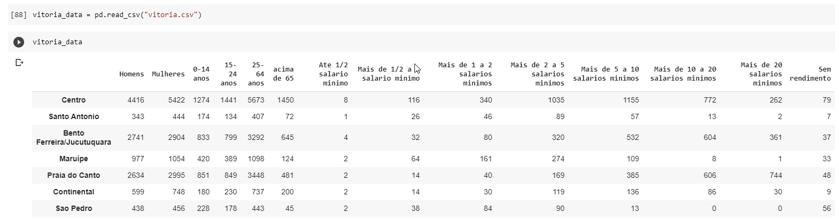
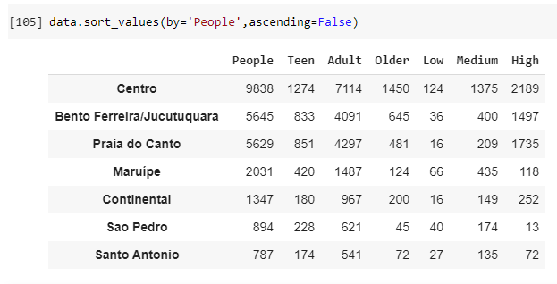
Treating data:

Slide 8
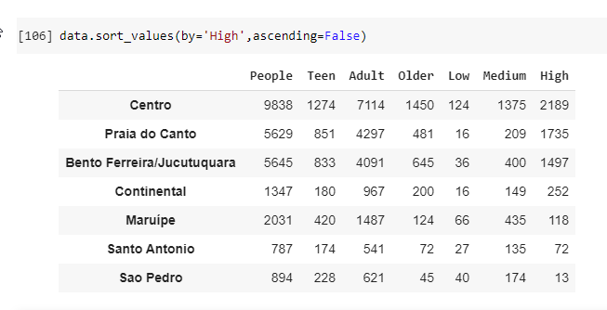
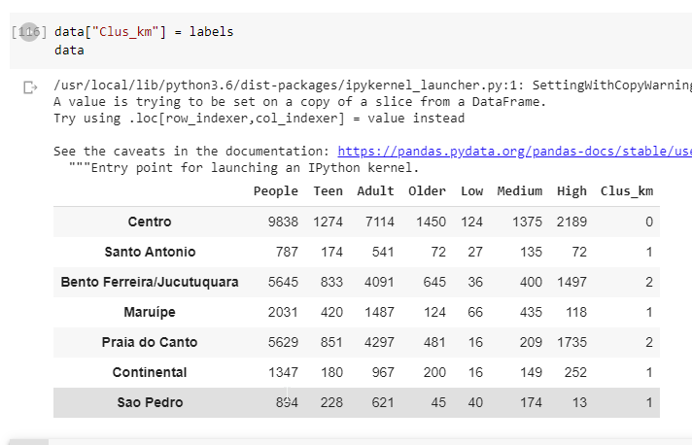
Sorting Values:

Slide 9
Results:
Crossing with data from Foursquare it’s possible to see that there is no significant places there. Due this, the best place to open a bar in Vitória, according to the data available is “Praia do Canto” that has the highest income.

Slide 10
Questions?

